Slide 1

RAGHU ENGINEERING COLLGE
(Autonomous)
Department of EEE
Academic Year : 2019-2020 III Year II-Semester
MINI PROJECT ON
“AUTOMATED PARALYSIS PATIENT HEALTHCARE MONITORING SYSTEM”
Batch No:10
Mr. K.KARTHIK (18985A0246)
Mr. L.RATHANKAR RAO (18985A0247)
Mr. M.G.NAIDU (18985A0248)
Ms. M.JAGAPATHIVARMA (18985A0249)
Mr. M.SAI (18985A0250)
FACULTY GUIDE:
Dr.P. RAJA GOPAL
FACULTY INCHARGE:
Mr.T. SATYANARAYANA

Slide 2
Overview
1.About paralysis patient
2.Facial deformation
3 Objective
4.problem description & focus of the project
5.System design and implementation
6 specifications & components
7.Circuit diagram & connections
8.Monitoring system
9.Process for the connection of IP Webcam
10 Results & conclusion

Slide 3

Paralysis patient

Slide 4


Slide 5

Facial deformation

Slide 6
“Health is one of the global challenges for humanity”
OBJECTIVE :-
This project may play vital role in saving the patient life at emergency time since “Time is life”
PROBLEM DESCRIPTION AND FOCUS OF THE PROJECT
Paralysis is the inability to move muscles on your own and with purpose.
It can be temporary or permanent. The most common causes are stroke, spinal cord injury.
Paralysis can be a complete loss of movement known as plegia, or a significant weakness called paresis.
Paralysis is most often caused by damage in the nervous system, especially the spinal cord.

Slide 7
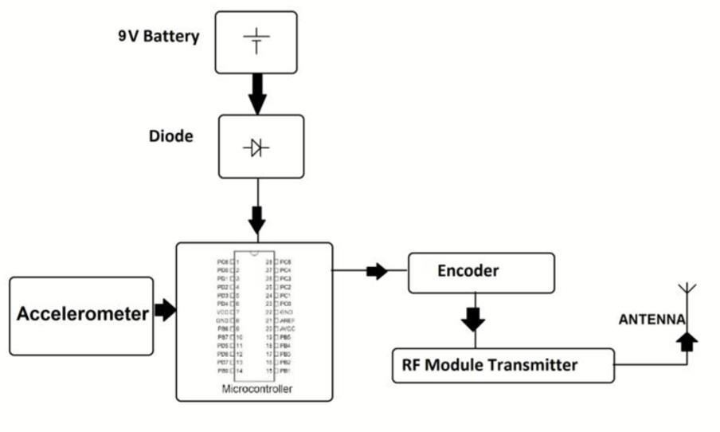
SYSTEM DESIGN AND IMPLEMENTATION
To overcome all the above drawbacks and meet the requirements of the system, we propose a system which mainly consists of a transmitter and a receiver section.
TRANSMITTER

Slide 8
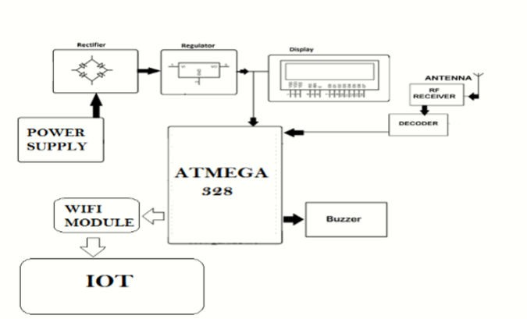
RECIEVER

Slide 9
HARDWARE SPECIFICATIONS AND CONNECTIONS
Components Required:-
Atmega Microcontroller Uno
Arduino Nano
Accelerometer & Gyro
RF Tx Rx
LCD Display
Resistors
Capacitors
Transistors
Cables and Connectors
Diodes
PCB and Breadboards
LED
Transformer/Adapter
Switch
IC
IC Sockets

Slide 10
Specifications:
Hardware Specification
1.Transmitter,2.Rectifier,3.Regulator,4.LCD,5.Antenna,6.RF Receiver,7.Buzzer,8.Atmega 328 Microcontroller,8051 Microcontroller,9.GSM Modem,10.Accelerometer,11.RF module Transmitter
Software specification
Arduino Compiler
MC Programming Language: C

Slide 11
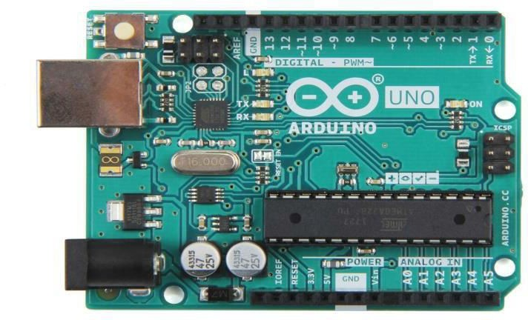
Arduino Uno
The Arduino Uno is an open-source microcontroller board based on the Microchip ATmega328P microcontroller and developed by Arduino.cc.
The board is equipped with sets of digital and analog input/output (I/O) pins that may be interfaced to various expansion boards (shields) and other circuits.
The board has 14 Digital pins, 6 Analog pins,

Slide 12
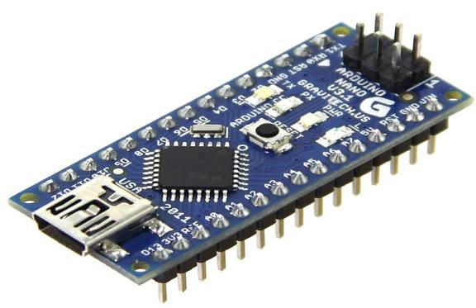
ARDUINO NANO
The Arduino Nano is a small, complete, and breadboard-friendly board based on the ATmega328P (Arduino Nano 3.x).
It has more or less the same functionality of the Arduino Duemilanove, but in a different package.
It lacks only a DC power jack, and works with a Mini-B USB cable instead of a standard one.

Slide 13
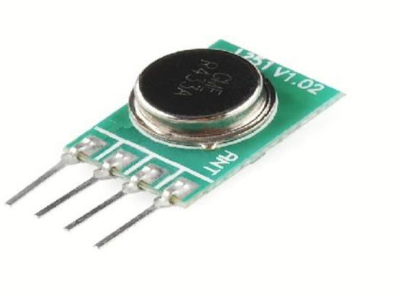
RF TRANSMITTER
This wireless data is the easiest to use, lowest cost RF link we have ever seen! Use these components to transmit position data, temperature data, and even current program register values wirelessly to the receiver.
These modules have up to 500 ft range in open space. The transmitter operates from 2-12V. The higher the Voltage, the greater the range .

Slide 14
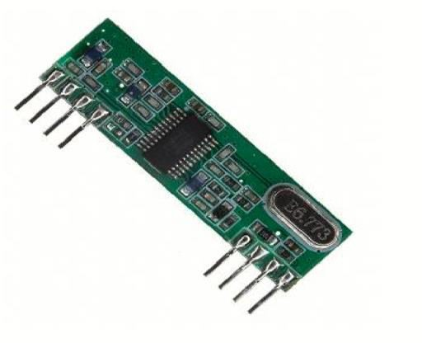
RF RECIEVER
This receiver type is good for data rates up to 4800bps and will only work with the 434MHz o 315 MHz transmitter.
Multiple 434MHz or 315MHz receivers can listen to one 434MHz transmitter or 315 MHz transmitter.

Slide 15
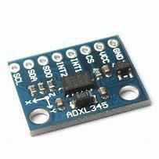
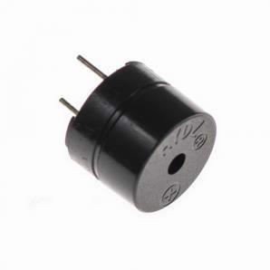
ACCELEROMETER & GYRO
The ADXL345-EP is an extended performance version of the ADXL345, which is a small, thin, ultralow power, 3-axis accelerometer with high resolution (13-bit) measurement at up to ±16 g. Digital output data is formatted as 16-bit twos complement and is accessible through either a SPI (3- or 4-wire) or I2C digital interface.
BUZZER 5V DC
Buzzer is an audio signaling device that has many applications includes timers and alarm devices. Many types of buzzers are available mainly they are electromechanical, mechanical and electrical buzzers.

Slide 16
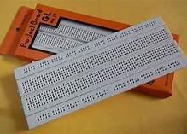
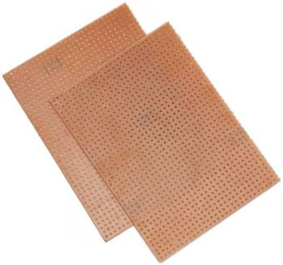
BREAD BOARD
PCB BOARD

Slide 17
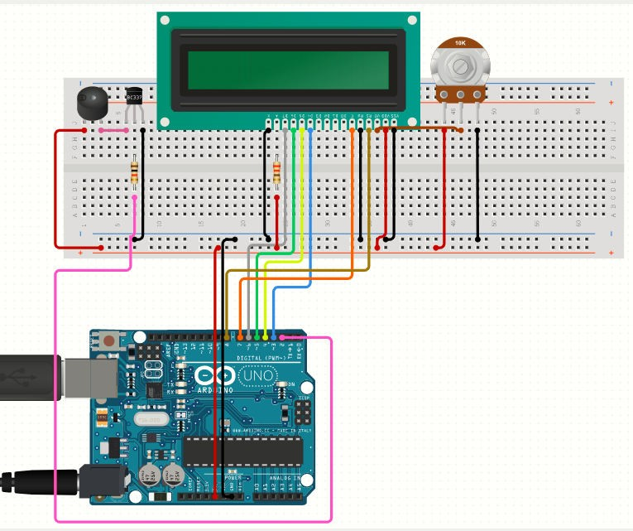
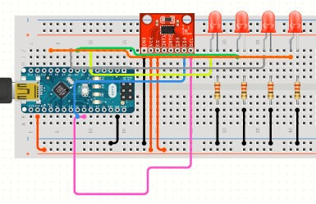
CIRCUIT DIAGRAM & CONNECTIONS
TRANSMITTER CIRCUIT
Similarly connect the VCC Pin of OLED Display to Arduino 3.3V pin and GND to GND.
Connect a buzzer to Arduino digital pin 8 and other pin to GND.
RECEIVER CIRCUIT
Connect accelerometer sensor VCC pin to Arduino 5V Pin and GND to GND.
Connects its signal pin to Arduino Analog pin A0.
Connect its SDA & SDL pins to Arduino A4 & A5 pins respectively

Slide 18

MONITORING SYSTEM

Slide 19
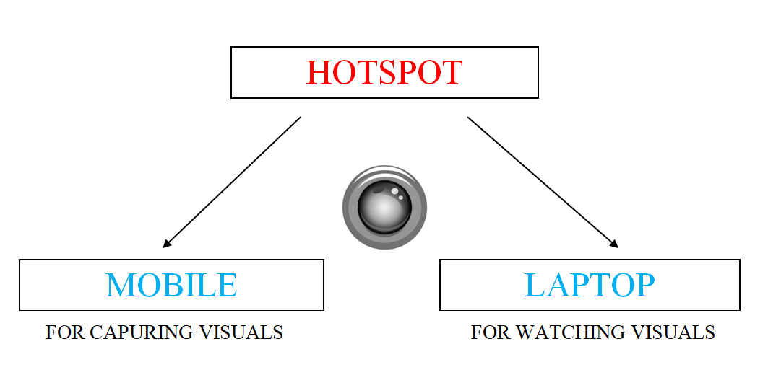
PROCESS FOR THE CONNECTION OF IP WEBCAM

Slide 20
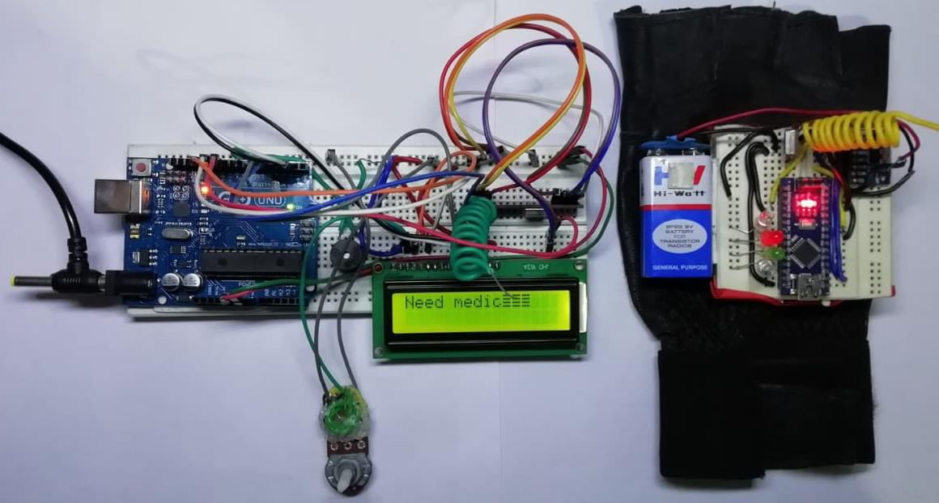
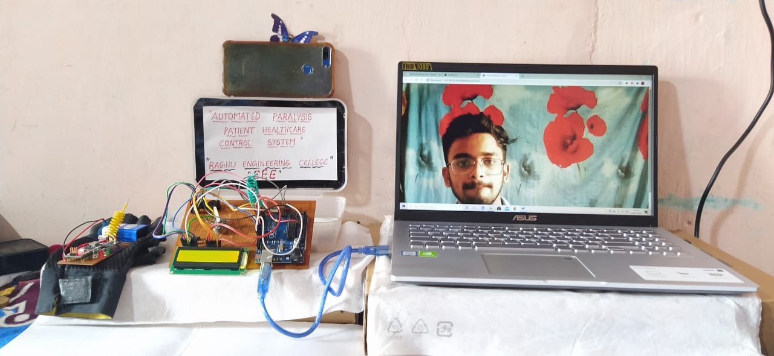
RESULTS
BEFORE EXTENSTION
AFTER EXTENSTION

Slide 21
CONCLUSION
By taking a overall survey, it can be found that there are many problems existing for the paralyzed people such as paralysis in their leg, hand, vocal tract and also in other body parts.
There are systems existing for their comforts individually. But, this system will help to monitor all the factors that cause paralysis and intimate that to the caretakers so that treatment can be given before the paralysis reaches hike.
This system helps patient overcome barriers to convey their needs without putting efforts. Moreover this can be modified to be used for several purposes where person’s mobility is affected.

Slide 22
THANK YOU

